Slide 1

US Real Estate.
Predicting Real Estate Prices Using PySpark
Course: IST 718
Group 6
Kelly Arseneau
Ryan Brown
Kevin Hansen

Slide 2
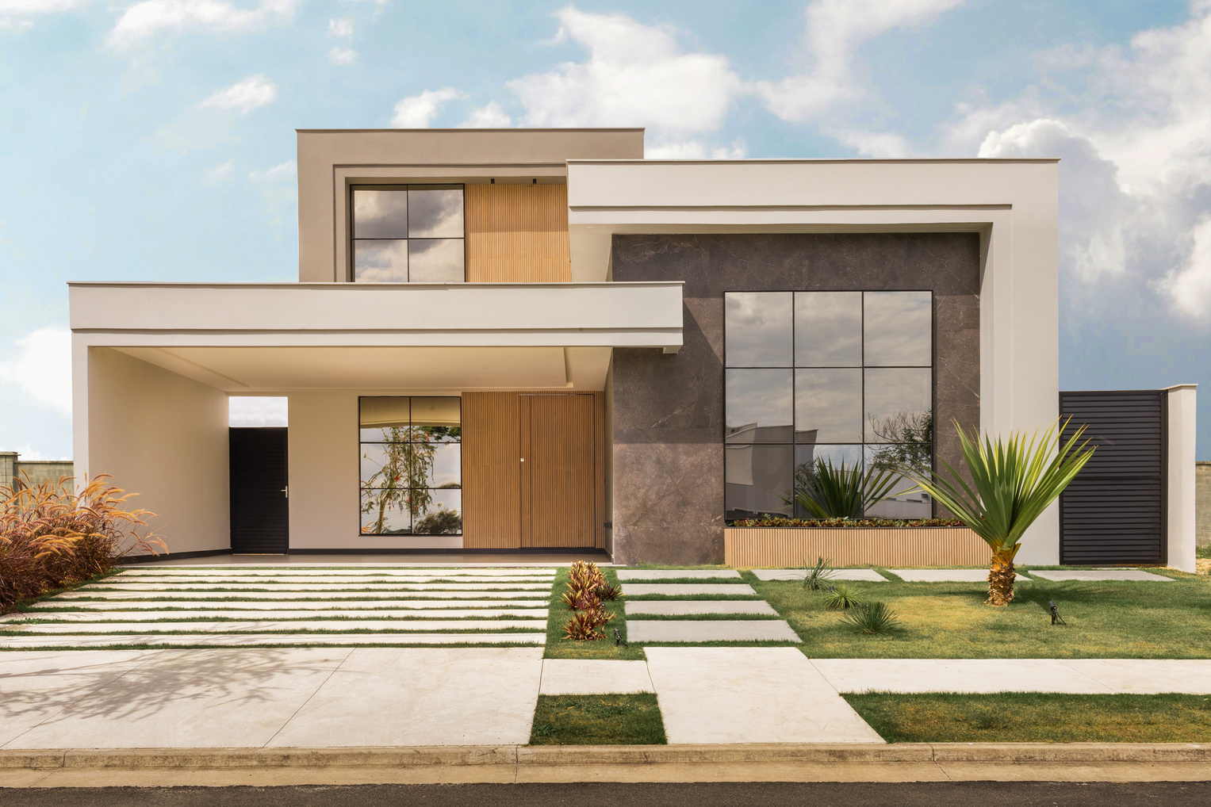
Project Overview
A machine learning model was built to predict housing prices based on key property characteristics.
The goal is to simulate a real estate price estimator that delivers an expected home price using inputs like beds, baths, square footage, and zip code.
Our final model was developed in PySpark, chosen for its scalability and speed on large datasets.
Target users: prospective homebuyers and real estate analysts.
A comprehensive Real Estate dataset from across the United States for the year 2024. The dataset was comprised of 1,048,575 real estate listings nationwide, featuring key attributes including price, number of bedrooms and bathrooms, house size, lot size, and location details (city, state, and zip code). However, the dataset required extensive preprocessing to ensure consistency, accuracy, and readiness for predictive modeling.

Slide 3

Prediction Goals:
Predict home prices using user-specified inputs:
Zip code
Number of bedrooms
Number of bathrooms
House size
Prioritize model interpretability and generalization:
Use features that are intuitive and easily understood by non-technical users
Favor models (like Gradient Boosted Trees) that provide insight into feature importance and allow for post-hoc explanations
Aim for a model that analysts and homebuyers can trust and interpret, not just a black-box prediction
Ensure low error and consistent performance on unseen homes:
Design the model to generalize well to new listings by avoiding overfitting
Use proper train-test splits and validation techniques to simulate real-world performance
Track metrics like RMSE, MAE, and MAPE to confirm stability and reliability across price ranges and geographic areas

Slide 4

The Dataset
Source: Kaggle USA Real Estate Dataset, containing over 1 million property listings across the United States.
Final dataset: Reduced to approximately 470,000 high-quality records after extensive cleaning and filtering steps, including:
removal of duplicates,
non-residential properties,
extreme outliers, and
listings with missing critical data.
Key features used for modeling:
price: Target variable, log-transformed for stability
bed, bath: Bedroom and bathroom counts, treated as numeric predictors
house_size: Square footage of the home, log-transformed to reduce skew
lot_size: In acres, also log-transformed due to extreme range
zip_code: Categorical, encoded using index mapping for modeling
Figure 1

Slide 5
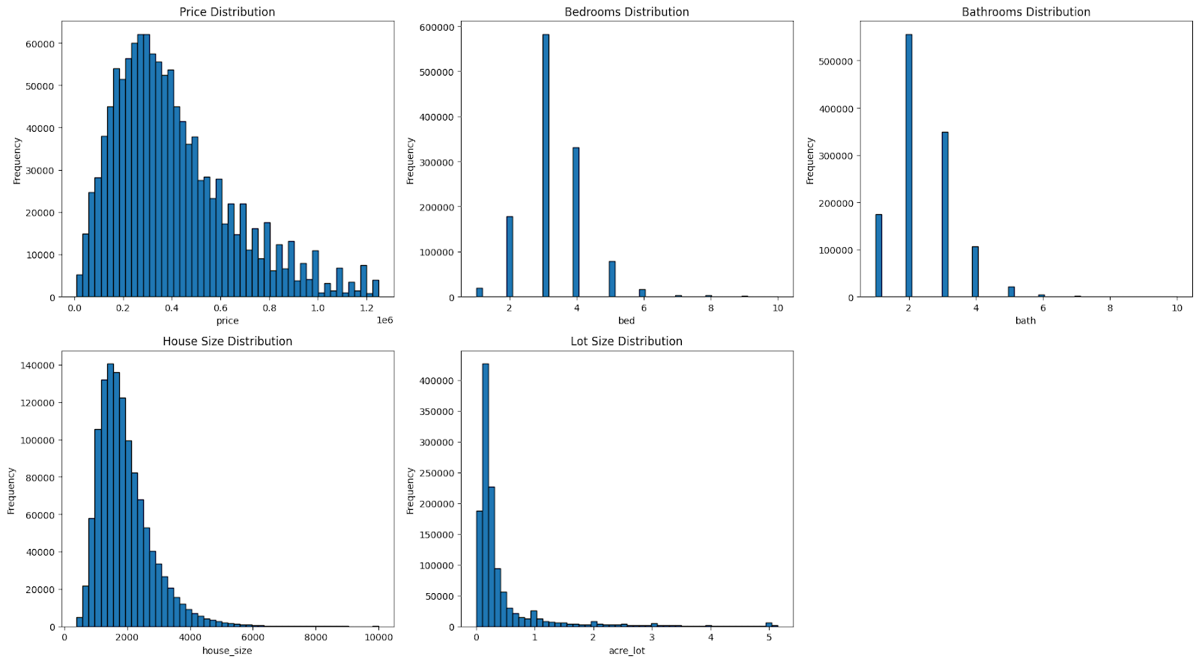
Data Exploration
Detected and removed non-residential properties based on missing key features and large lot sizes.
Filtered out unrealistic values (e.g., 0 beds, 30+ baths, tiny or massive square footage).
Removed top 1% of home prices to reduce model error and improve generalization.
Applied log transformations to skewed features (price, house size, acre lot) for better distribution and modeling.
Average Home Price: $300,000 - $400,000
Typical Property:
3 Bedrooms
2 Bathrooms
~2,000 sq ft house size
~0.25 acre lot size
Figure 1

Slide 6
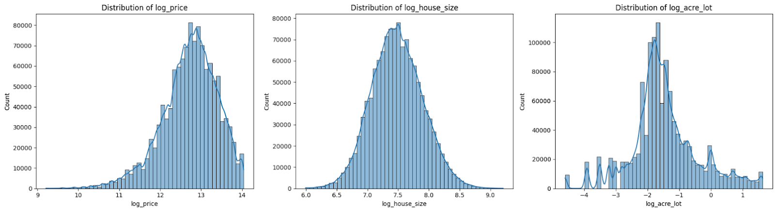
Data Exploration
Log transformations reduced skew and brought key variables closer to normal distribution.
log_price and log_house_size now display strong bell-shaped curves, ideal for regression.
log_acre_lot improved but still shows some skew and variability.
These transformations helped stabilize the model and minimize the impact of outliers.
These observations are depicted in Figure 2.
Figure 2

Slide 7
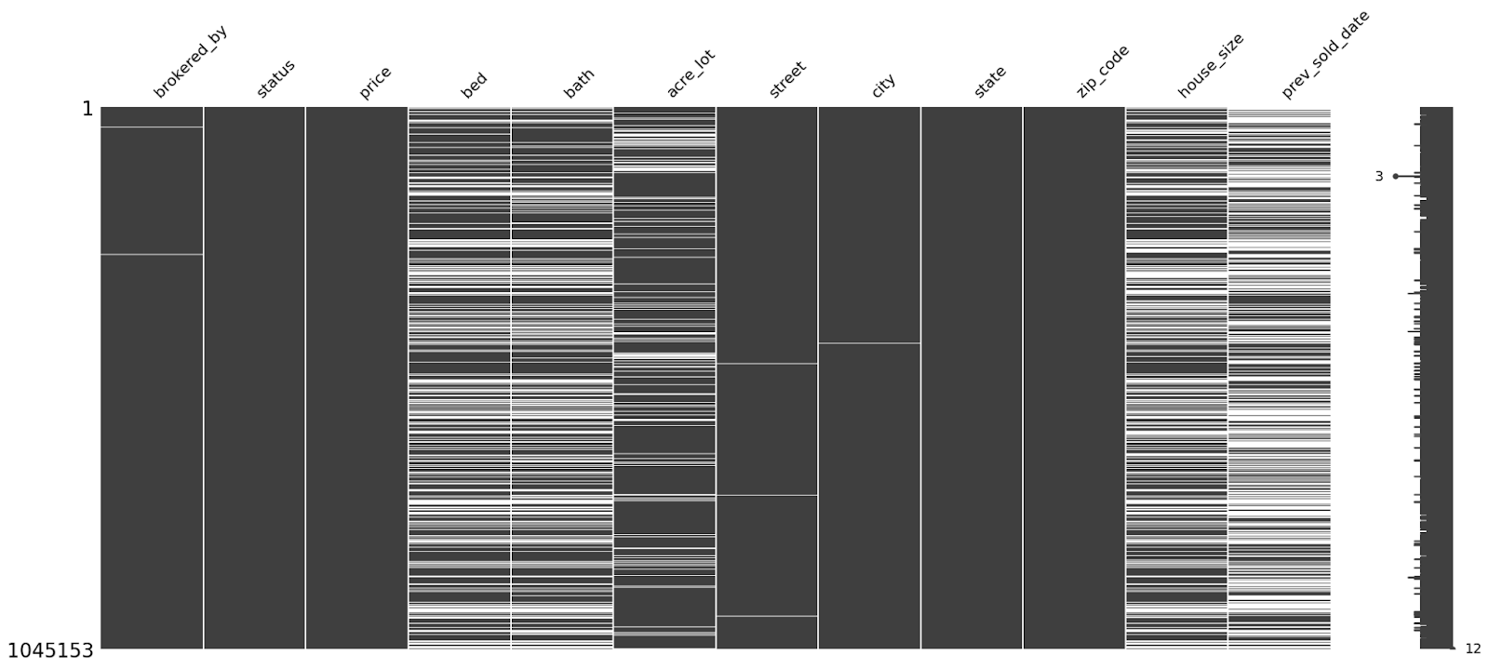
Data Cleaning
The data cleaning and preprocessing involved several key steps:
Excluded non-U.S. territories (e.g., Puerto Rico, Virgin Islands)
Removed irrelevant columns (e.g., brokered-by, street) for privacy and analysis clarity
Capped extreme outliers and filtered non-residential properties
Corrected zip codes (missing leading zeros, placeholders like 99999)
Imputed missing values using medians (state or dataset)
Assigned city names based on most common value per zip code
Categorized house sizes for structured comparison
Removed rows with missing city data
Resulted in a clean dataset of 680,399 listings, ready for modeling
Figure 3

Slide 8
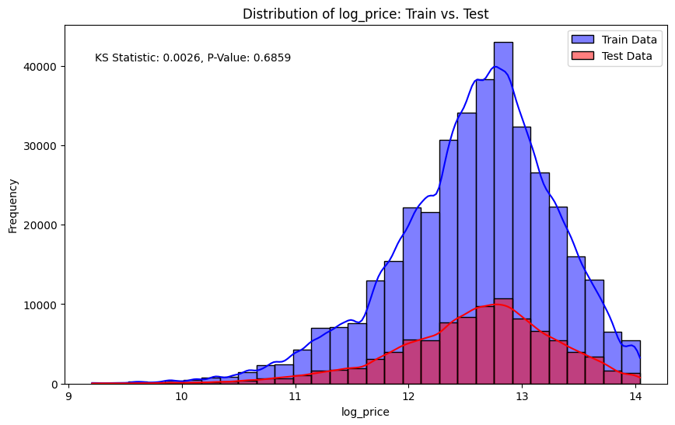

Model Training
Train-Test Split & KS Test
We used an 80/20 random split to divide the dataset into training and testing sets.
To verify that the split was representative of the overall dataset, we ran a Kolmogorov–Smirnov (KS) test comparing price distributions.
The test returned a p-value of 0.6859, indicating no significant difference between training and test sets, and the split was statistically representative of the dataset.
This confirmed that our evaluation metrics on the test set would reflect real-world generalization performance.

Slide 9

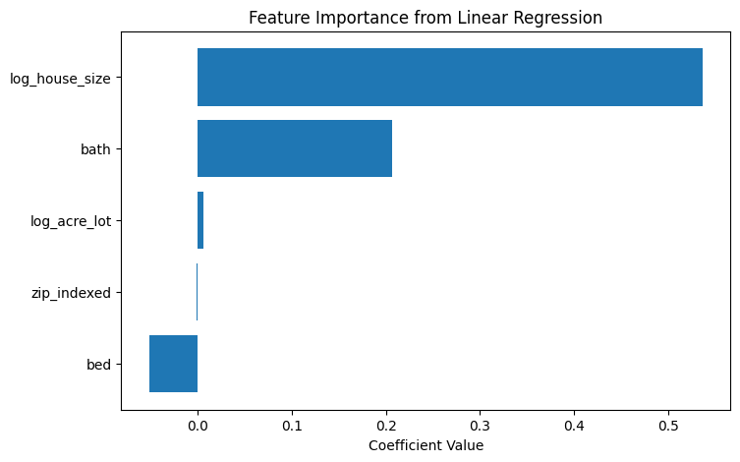
Linear Regression
The objective of this analysis was to develop a predictive model for housing prices using Linear Regression. The dataset encompassed key features such as the number of bedrooms, bathrooms, lot size, house size, along with engineered features including price per acre and price per square foot. Data preparation included excluding non-numeric features (e.g., city and zip code) and applying Min-Max scaling for consistent feature ranges.
Results
Our baseline model was a linear regression using log-transformed features.
Performance on the test set:
R² = 0.458, meaning the model explained ~46% of price variance.
RMSE ≈ $130,000, showing moderate error in price prediction.
Key limitations:
Assumes all relationships are linear
Lacked encoded zip code information
Underperformed on higher-priced homes due to oversimplification
Limitations of Linear Regression
Assumes linear relationships, overlooking feature interactions (e.g., house size & lot size)
Excludes important location-based data (e.g., zip codes)
Alternative: Random Forest
Handles feature interactions and evaluates feature importance
Can incorporate categorical variables (e.g., zip codes) for improved prediction accuracy

Slide 10
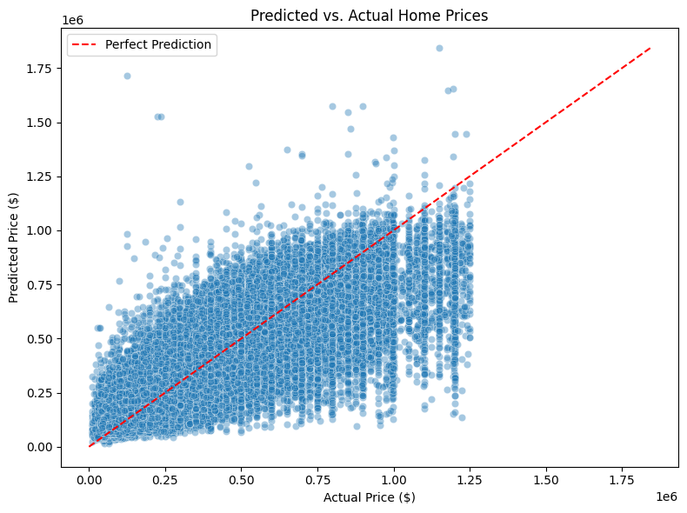
Gradient Boosting Trees Model
A Gradient Boosting Trees (GBT) model is an advanced machine learning algorithm utilized for both classification and regression tasks. It leverages the strengths of decision trees and ensemble learning to produce highly accurate predictions. The model works by iteratively constructing decision trees, with each new tree aiming to correct the errors of the preceding one. The predictions from all trees are then combined to generate the final output. This approach enhances predictive performance by reducing bias and variance.
Model Performance
Improvement Opportunities
Strengths:
Excels in generalizing for mid-priced homes
Effective for trend analysis
Challenges:
Struggles with high-priced properties due to heteroscedasticity
Potential Enhancements:
Add features like location types, luxury indicators, or regional models
Consider advanced techniques such as XGBoost for improved precision on luxury homes
Train R²: 0.7465 (explains 74.7% of variance in training data)
Test R²: 0.7076 (explains 70.8% of variance in testing data)
Mean Absolute Error (MAE):
Training: $80,347.01
Testing: $85,965.94
Root Mean Square Error (RMSE):
Training: $120,266.90
Testing: $130,029.94
Conclusion: Demonstrates moderately strong performance in predicting housing prices

Slide 11
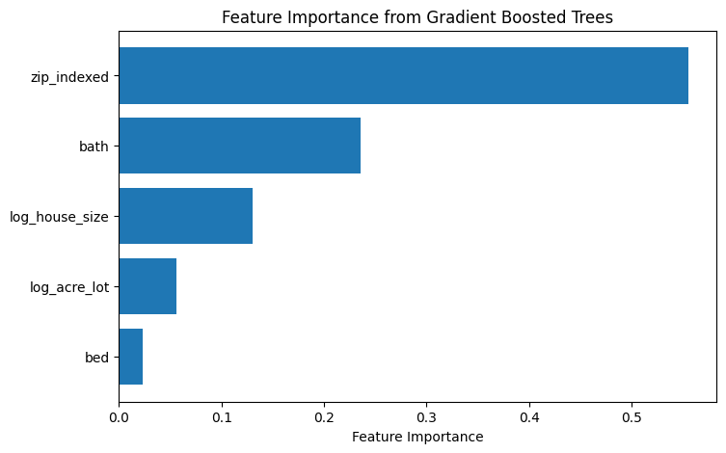
GBT Feature Importance
GBT model provided ranked feature importances:
zip_indexed: 54.5% — reflects geographic market effects
bath: 29.6% — bathrooms have significant pricing impact
log_house_size: 15.8% — larger homes correlate with higher prices
Other features (like bed and log_acre_lot) had smaller influences but added marginal predictive power.
Impact: Removing Top 1% of Home Prices
Model Performance & Improvement Opportunities
Effect on Errors:
Slight reduction in RMSE and MAE
Minimal impact on R², indicating limited influence of high-end outliers on model performance
Outcome:
Cleaner model with maintained effectiveness on unseen data
MAPE: 30.58%
Reflects reasonable trend capture, though individual price predictions can vary significantly
Strengths:
Excels in generalizing for mid-priced homes
Effective for trend analysis
Challenges:
Struggles with high-priced properties due to heteroscedasticity
Potential Enhancements:
Add features like location types, luxury indicators, or regional models
Consider advanced techniques such as XGBoost for improved precision
on luxury homes

Slide 12
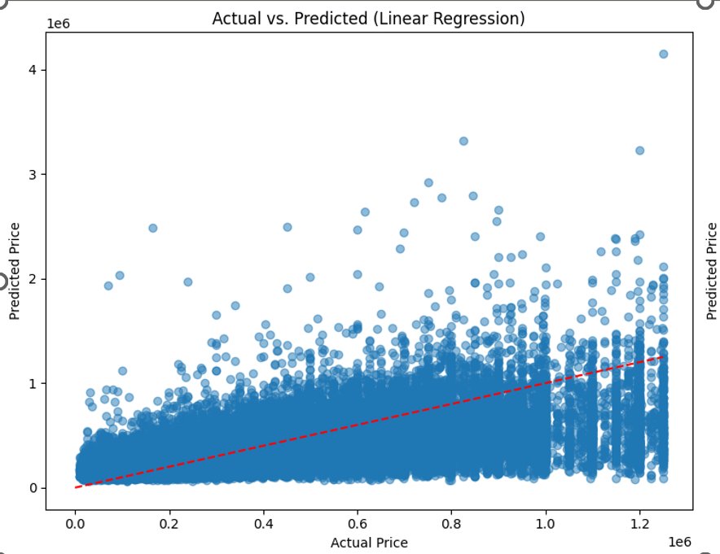
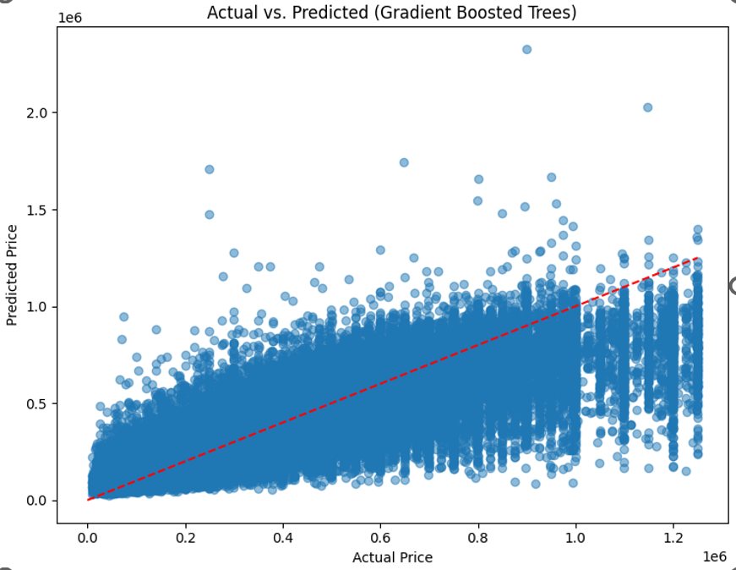
Model Performance: Actual vs. Predicted Prices
These plots visualize how accurately each model predicted home prices compared to actual values.
Linear Regression:
Significant scatter and underprediction, especially for higher-priced homes.
Prediction line deviates from the perfect fit (red dashed line), indicating poor handling of nonlinear trends.
Gradient Boosted Trees (GBT):
Predictions are more tightly clustered around the ideal prediction line.
Performance improves, particularly for mid-range homes, though error still increases at the luxury end.
Overall, GBT captures non-linear patterns and interactions more effectively than linear regression.

Slide 13
Ideas for future processing
Where the model struggles
Although the current Gradient Boosted Trees model performs well (R² ≈ 0.71), several steps can be taken to improve accuracy, interpretability, and real-world usability:
Integrate location-based features (e.g., city, neighborhood, school ratings, proximity to amenities)
Use latitude/longitude for spatial modeling (e.g., geohashing)
Split house size into finished vs. unfinished square footage and add features like lot size and garage size
Segment modeling by price tiers or create a separate luxury property model
Implement advanced techniques (XGBoost, LightGBM, neural networks) and incorporate temporal data
Improve deployment with a user-friendly interface, confidence intervals, SHAP values, and expanded data sources
Enhance Location Features Beyond Zip Code Zip code is the strongest predictor, but it's still a broad geographic grouping.
The model generalizes well for mid-priced homes, but struggles as prices climb — a common issue in regression with heteroscedasticity (variance increases with target).
Even after removing the top 1%, high-priced homes are still harder to model — may require adding features like location type, luxury indicators, or separate modeling.

Slide 14

Conclusion
The current model is a strong foundation — it effectively predicts home prices based on user-specified inputs like beds, baths, square footage, and zip code. Moving forward, enriching the dataset and tailoring the modeling strategy to address outliers and spatial nuances will help turn this into a production-ready tool.

Slide 15

Thank You!

